Slide 1
RAJIV VIDYA MISSION (SSA),NALGONDA
INFORMATION
ABOUT IE ACTIVITIES IN NALGONDA DISTRICT
Prepared by
M.RAMI REDDY
IE CO-ORDINATOR
RVM NALGONDA

Slide 2
No. of Mandals = 59
TOTAL No. of CWSN Children CATEGORY WISE IN Nalgonda District Total
LV | TB | HI | SI | OI | MR | CP | MD | LD | ASD
645 | 184 | 1328 | 398 | 1778 | 2687 | 594 | 395 | 2774 | 31
TOTAL No. of CWSN=10814
Status of IERTs placement (including vacancies).
Sl. No | Name of the District | IERCs Mandals |  | Non - IERCs Mandals |  | Total. No. of Mandals in the District | Total No.of IERTs appointed
 |  | No.of Mandals | No.of IERTs appointed | No.of Mandals | No.of IERTs appointed
1 | NALGONDA | 20 | 40 | 39 | 55 | 59 | 95

Slide 3
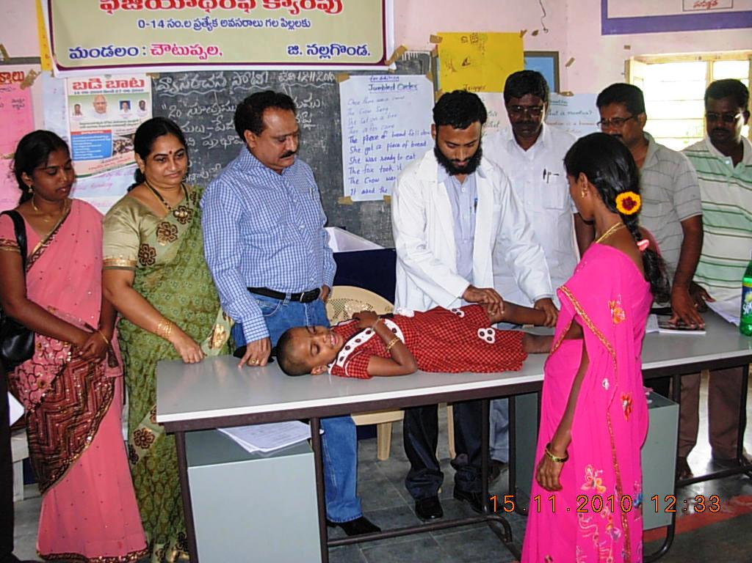
No.of IERTs appointed during the year 2011-12
Sl. No | Category | No.of IERTs appointed
01 | Hearing Impaired | 51
02 | Visually Impaired | 18
03 | Mentally Retorted | 26
 | TOTAL | 95
Escort Allowance:-
582 CWSN mainstreamed Children Escort allowance released to SMC accounts.
Physiotherapy:-
Physiotherapy camps are going to conduct in 4th week of August.

Slide 4
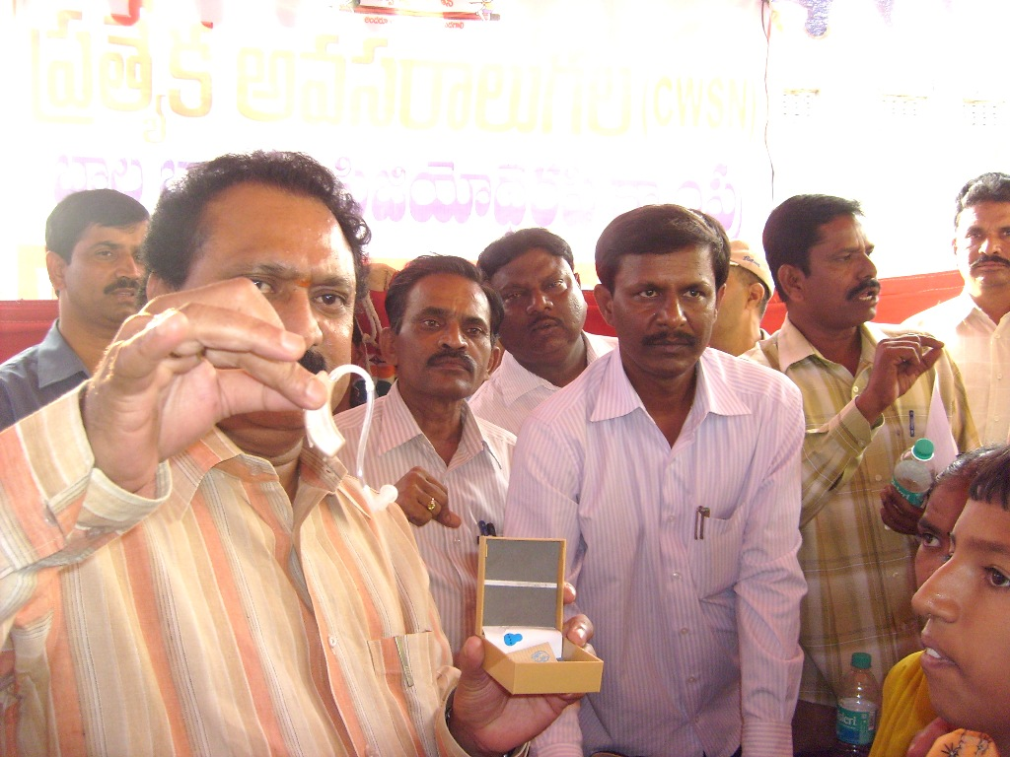
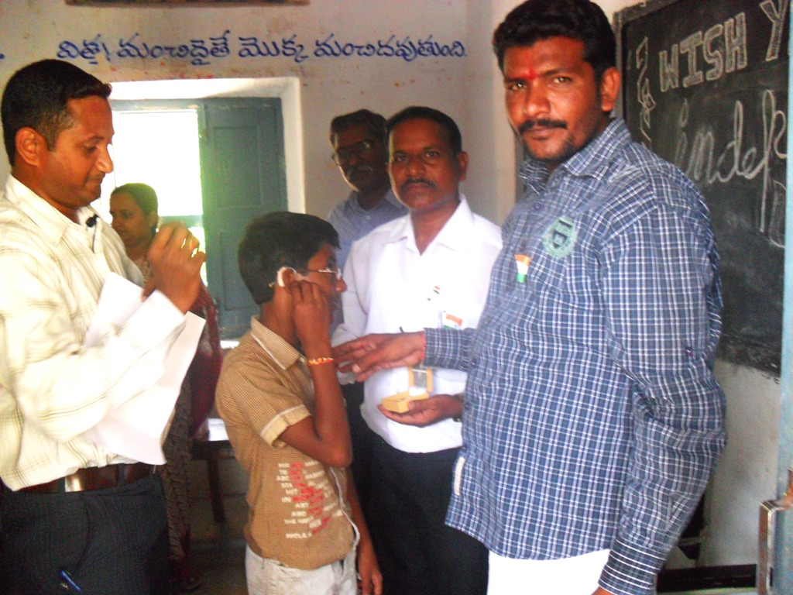
Aids & Appliances
183 BTEs (Behind the Ear) are distributed. Remaining 83 BTEs are to be distributed on 15th August-2011.

Slide 5
Particulars | Proposed Aids/Appliance from ALIMCO for 2010-11 |  |  |  |  |  |  |  |  |  | Total Amount | Particulars of remittence | Pending for previous years
 | Wheel Chairs (Child) | Wheel Chairs (Standard) | Tri-Cucle (R.H.Drive) | Tri-Cucle (C.H.Drive) | Cruthc (Small) | Crutch (Medium) | Braille cane/Slate | Hearing aaids | others | Total
Placed for Order | 259 | 137 | 114 | 23 | 32 | 8 | 0 | 326 | 0 | 899 | 3031236 | DD
Received so far | - | - | - | - | - | - | - | 326 | - | 326

Slide 6
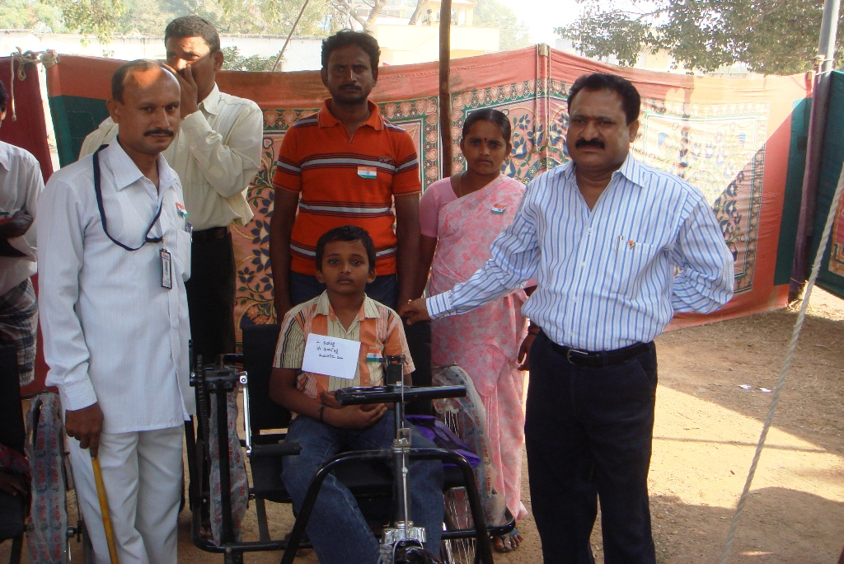
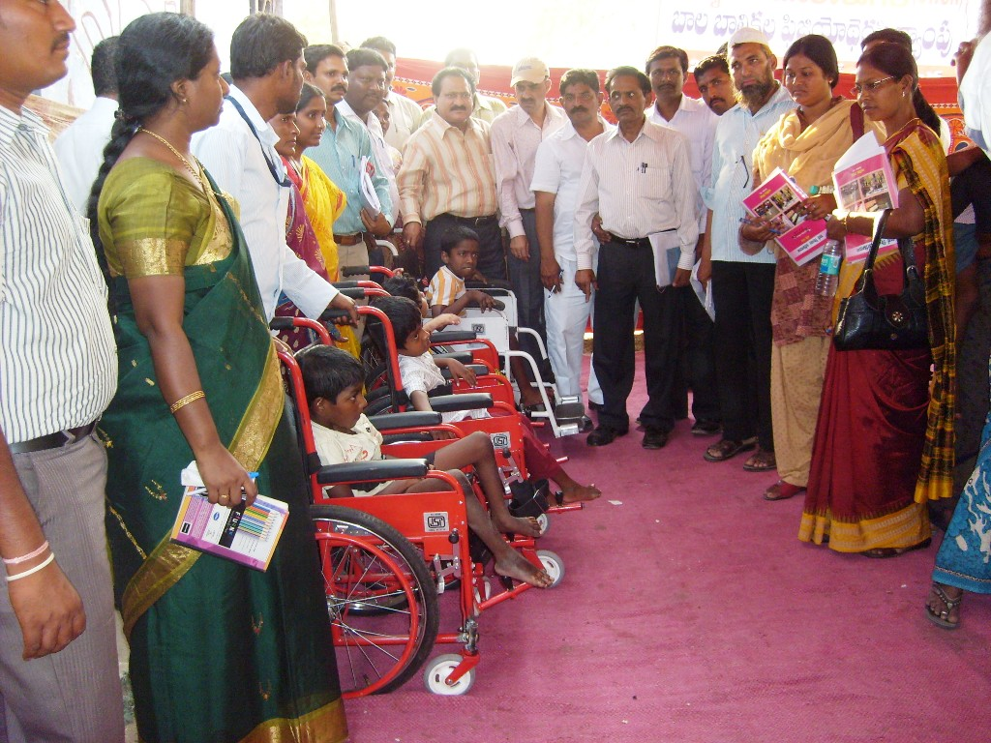
Status on opening of Sp1.RSTCs & NRSTCs
02 RSTCs (Residential Special Training Centres) are proposed at Devarakonda , Suryapet for Visually Impaired and Hearing impaired children.

Slide 7
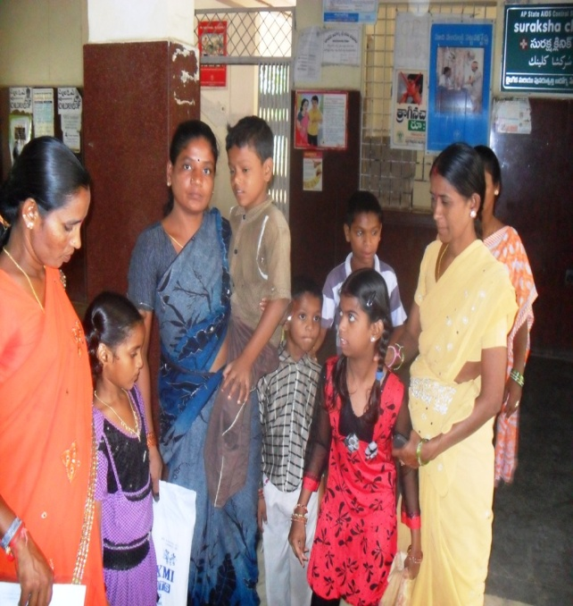
Identification of CWSN for minor surgical corrections by LLE at Guntur.
457 Children were identified for surgical corrections at LLE Guntur (List Enclosed).
Sl. No | Type of Surgery | No. of children
01 | Cleft Lip | 29
02 | Ortho Handicapped | 214
03 | Hearing Impaired | 126
04 | Epilepsy | 32
05 | Polio | 34
06 | Dental | 22
 | TOTAL | 457

Slide 8
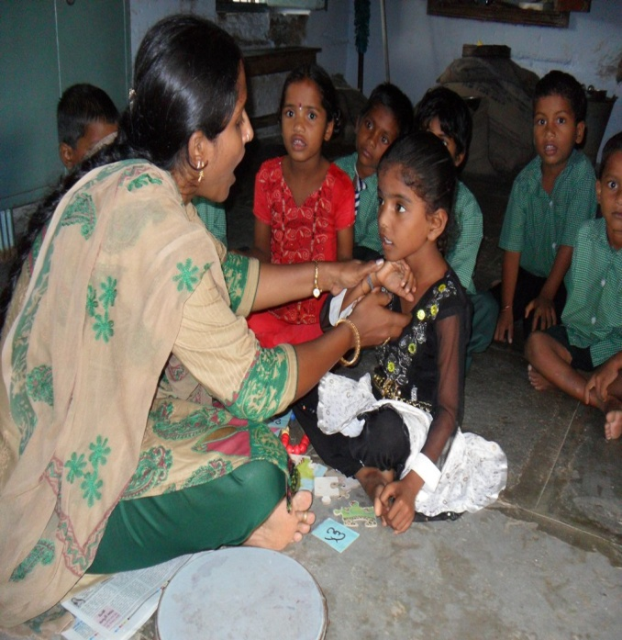
No. of Home Based Education Children – 608
Mainstreamed Children for the year 2011-12 = 548
Sl. No | Category | No.of children admitted into regular schools
01 | Hearing Impaired | 123
02 | Mentally retorted | 287
03 | Visually impaired | 62
04 | Cerebral Palsy | 64
05 | Ortho Impaired | 12
 | TOTAL | 548

Slide 9
Total child population (6-14 years) | No. of CWSN Identified | %CWSN against child pop
450170 | 10814 | 2.4%
RAJEEV VIDYA (SSA), NALGONDA
Release of funds & Expenditure intervention wise
Sl. No. | Name of the Intervention | Budget Sanctioned |  | Amount Received | Expenditure incurred as on 27.07.2011 | August exp upto 22.8.2011 | Total Expenditure incurred as on 22.08.2011
 |  | Phy | Fin | Fin | Fin | Fin | Fin
10 | Interventions for CWSN (IED) | 10494 | 272.84 | 91.00 | 0.70 | 11.05 | 11.75

Slide 10
Category wise coverage plan in IE for 2011-12
S.No | Category | No. of Identified |  |  | No. of CWSN to be enrolled in Schools |  |  | No. of CWSN to be Covered through School Readiness programmes |  |  | No. of CWSN to be Covered through HBE
 |  | Boys | Girls | Total | Boys | Girls | Total | Boys | Girls | Total | Boys | Girls | Total
1 | LV | 367 | 278 | 645 | 367 | 278 | 645 | 0 | 0 | 0 | 0 | 0 | 0
2 | TB | 114 | 70 | 184 | 54 | 37 | 91 | 60 | 33 | 93 | 0 | 0 | 0
3 | HI | 775 | 553 | 1328 | 732 | 496 | 1228 | 43 | 57 | 100 | 0 | 0 | 0
4 | SI | 221 | 177 | 398 | 221 | 177 | 398 | 0 | 0 | 0 | 0 | 0 | 0
5 | OI | 928 | 850 | 1778 | 928 | 850 | 1778 | 0 | 0 | 0 | 0 | 0 | 0
6 | CP | 376 | 218 | 594 | 206 | 83 | 289 | 27 | 13 | 40 | 143 | 122 | 265
7 | MR | 1531 | 1156 | 2687 | 1056 | 856 | 1912 | 52 | 28 | 80 | 423 | 272 | 695
8 | LD | 1624 | 1150 | 2774 | 1624 | 1150 | 2774 | 0 | 0 | 0 | 0 | 0 | 0
9 | MD | 230 | 165 | 395 | 123 | 65 | 188 | 4 | 3 | 7 | 103 | 97 | 200
10 | ASD | 18 | 13 | 31 | 9 | 2 | 11 | 0 | 0 | 0 | 9 | 11 | 20
 | Total | 6184 | 4630 | 10814 | 5320 | 3994 | 9314 | 186 | 134 | 320 | 678 | 502 | 1180

Slide 11
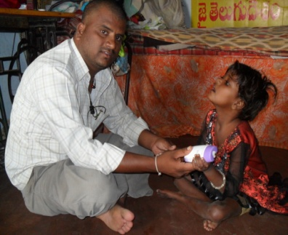
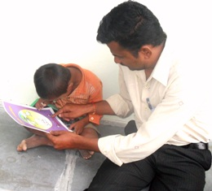
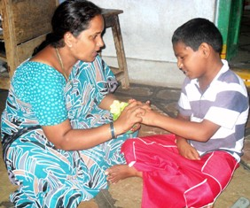
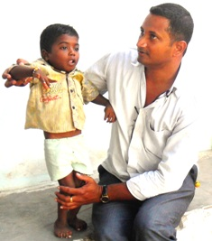
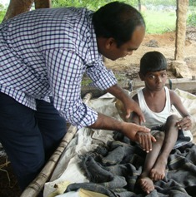
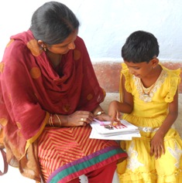
H.B.E (HOME BASED EDUCATION)

Slide 12
Thank You

